Slide 1
Food Sales Dashboard and
Business Insights
Domain: Business Intelligence & Data Analytics

Slide 2
Project Overview
• This project analyzes e-commerce sales data to uncover business insights.
• Built using Microsoft Power BI for visualization.
• Focused on Sales, Profit, Customer Segments, and Product Performance.
• Goal: Support business decision-making and improve revenue.

Slide 3
Dataset Details
• Dataset Name: Balaji Fast Food Sales
• Source: Kaggle
• Rows: 10,000+ | Columns: 15+ (Sales, Category, Date, Region, etc.)
• Data represents online sales transactions across multiple locations.

Slide 4
Data Cleaning & Transformation
• Removed duplicates and null values.
• Converted Date field to proper Date format.
• Standardized text fields (Product, Region names).
• Created new calculated fields (Revenue, Profit, Margin).

Slide 5
Power BI Dashboard Features
• Total Sales and Profit KPIs.
• Sales Trend over Months (Line Chart).
• Top Performing Product Categories (Bar / pie Chart).
• Sales by Region on Map Visualization.
• Customer Segment & Order Type Breakdown.

Slide 6
Insights Derived
• Some product categories show significantly higher profit.
• Sales peak during festival and discount seasons.
• Certain regions are strong markets compared to others.
• Profit margin varies by product, indicating pricing strategy opportunities.

Slide 7
Business Recommendations
• Increase inventory for high-demand product categories.
• Apply targeted discounts in low-performing regions.
• Improve delivery logistics to enhance customer satisfaction.
• Focus marketing efforts on top-performing customer segments.

Slide 8
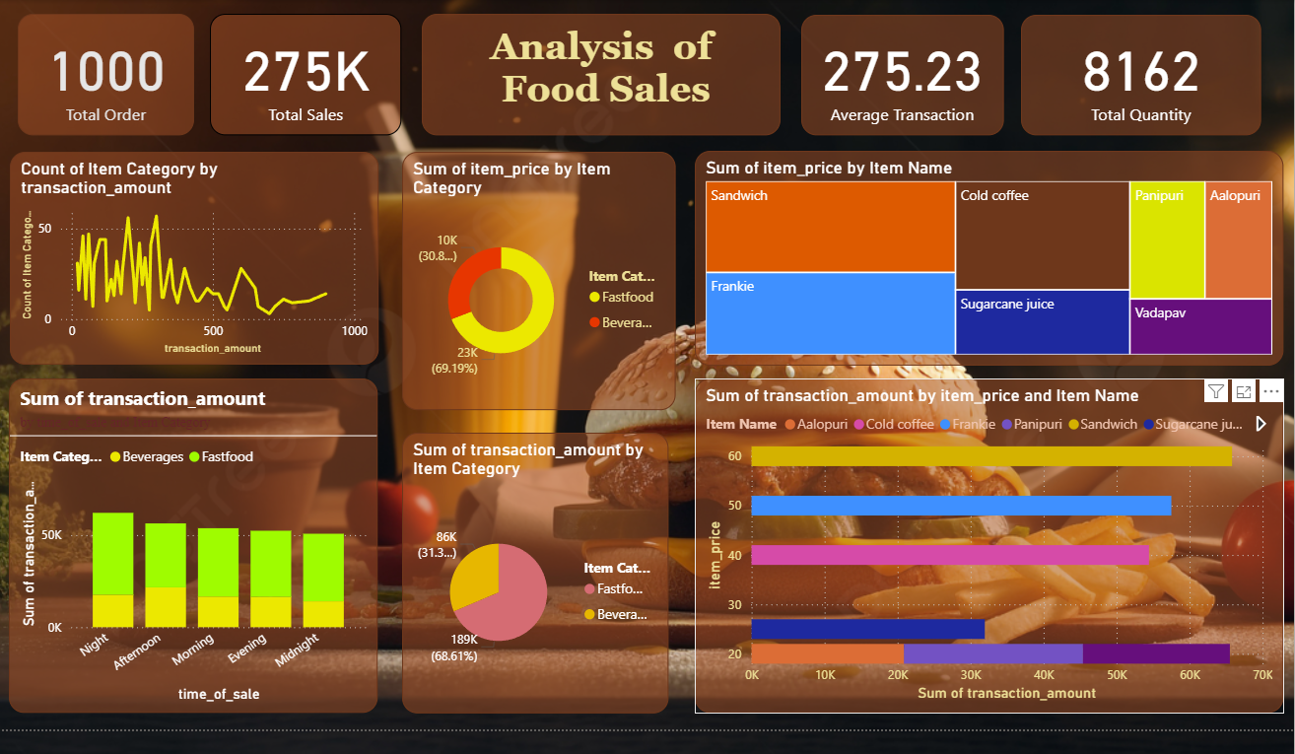
Dashboards

Slide 9
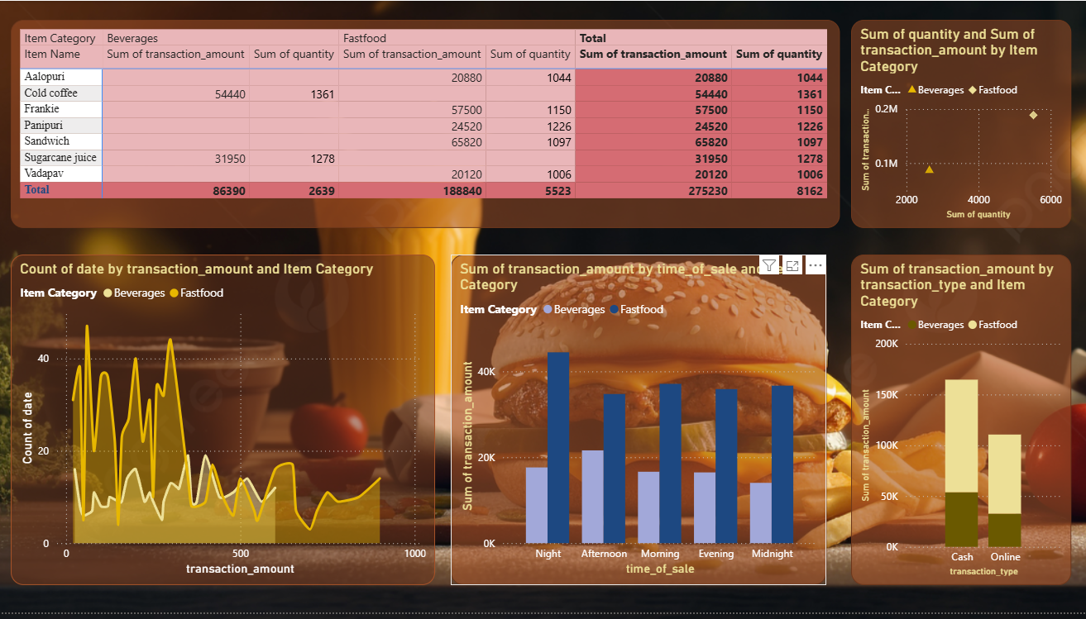

Slide 10
Conclusion
• Power BI enabled deep analysis of sales and profit performance.
• Dashboard provides actionable insights for decision-makers.
• Helps improve business growth and optimize revenue.
THANKYOU!

